Slide 1
Autosave Lab
John Sinclair,
Kay Kasemir
Feb. 2022

Slide 2
Procedure
Run IOC without autosave
Observe that changes are lost when IOC is stopped and restarted
Reconfigure with autosave and repeat

Slide 3
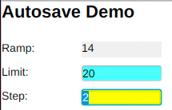
Run IOC without autosave
Build and run IOC
cd /ics/examples/09_autosaveApp
make
cd /ics/examples/iocBoot/ioc_autosave
./st.cmd
In another window
css –resource file:/ics/examples/09_autosaveApp/opi/autosave.bob
Change the “limit” and “step”
Stop the IOC, start it again
Did “limit” and “step” retain what you entered?

Slide 4
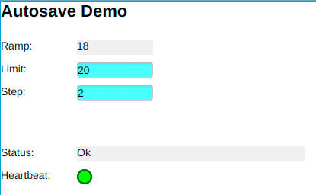
Configure IOC with autosave
Update IOC config and run IOC
Note the “Include AUTOSAVE support” section in here:
gedit /ics/examples/09_autosaveApp/src/Makefile
So autosave support was already included, but not configured.
Adjust the IOC startup file, save it, then run IOC
cd /ics/examples/iocBoot/ioc_autosave
gedit st.cmd
./st.cmd
When you now adjust “limit” and “step”, wait 5 seconds, stop and restart the IOC, does it retain what you entered?
Check the *.db file that you load for “info…” tags
that select what to save/restore

